Slide 1
My summer holidays
place
transport
weather
activities
impression

Slide 2
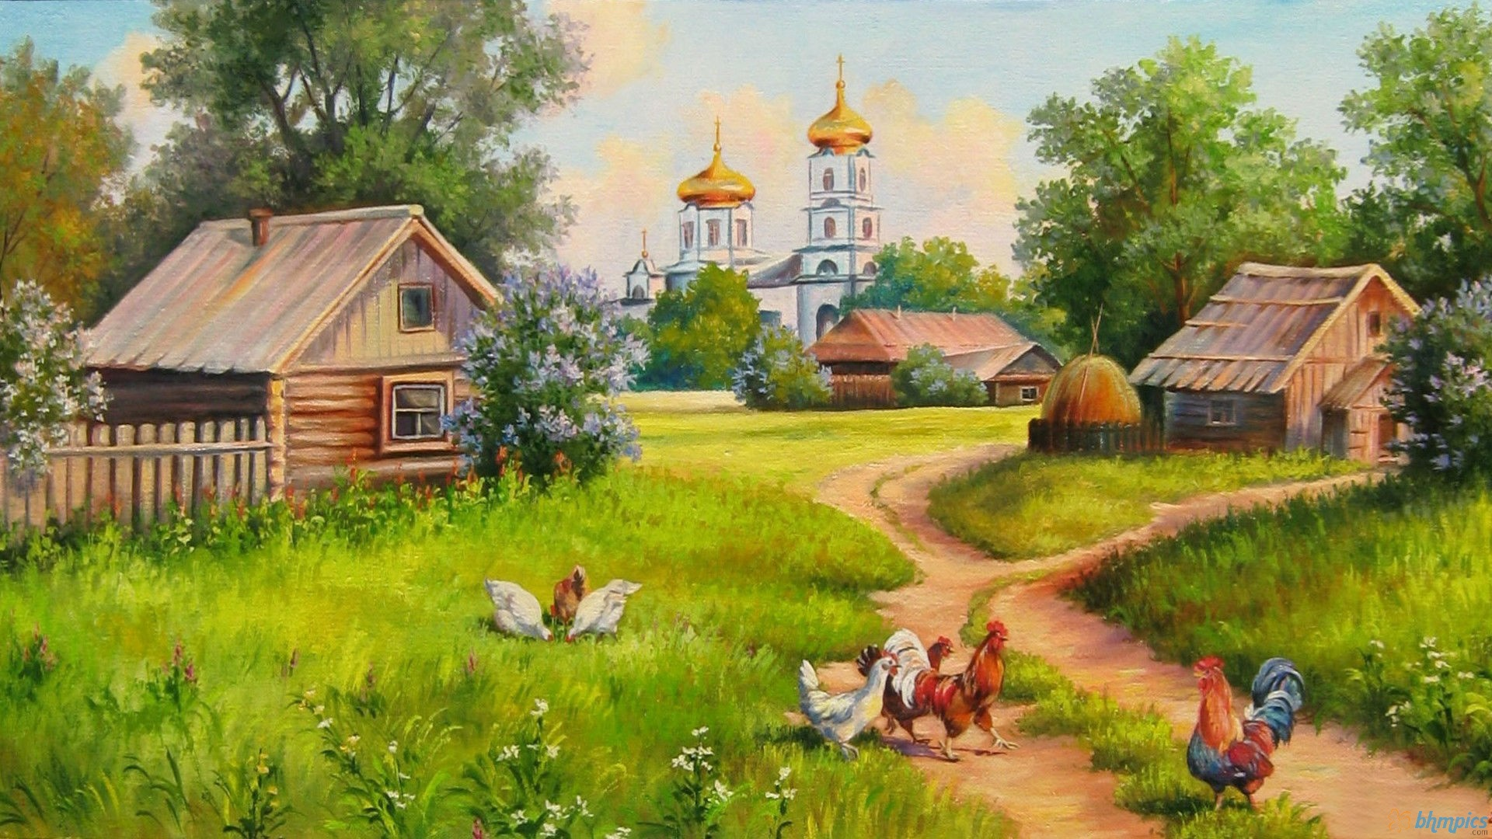
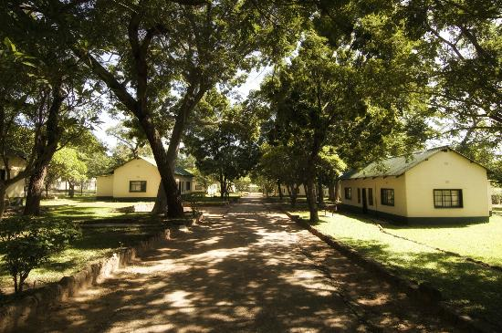
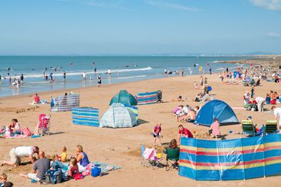
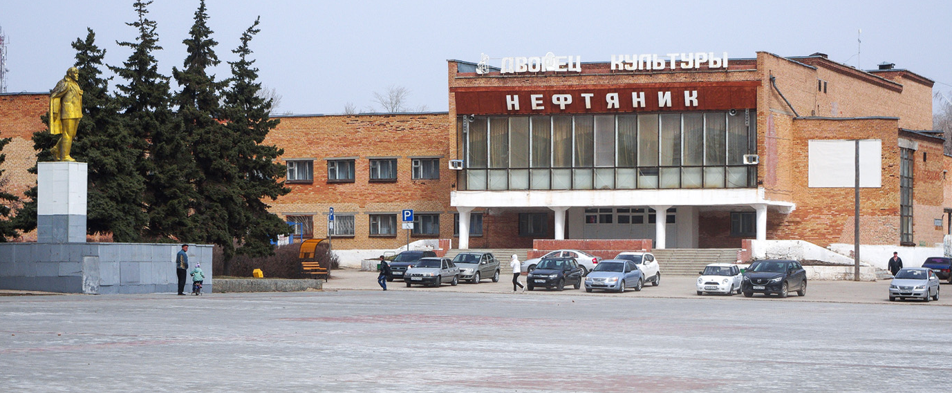
go to the village
go to the summer camp
go to the seaside
stay in my home town

Slide 3
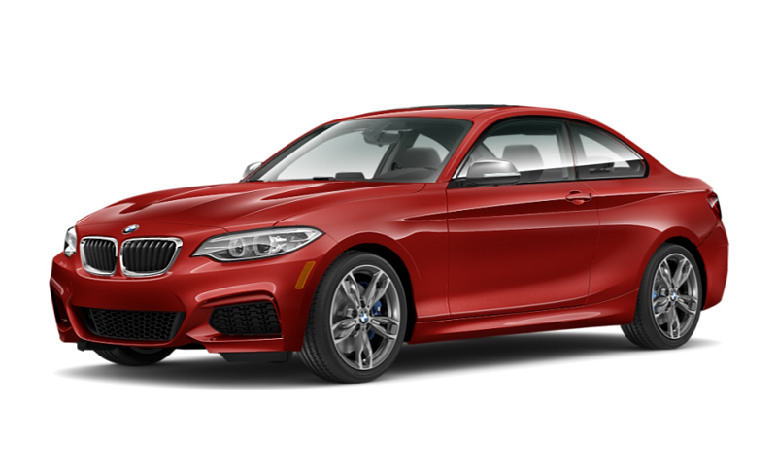
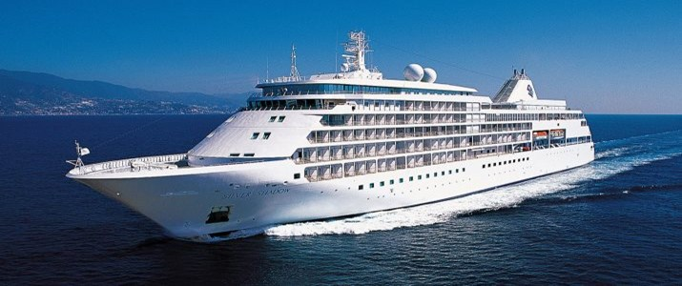
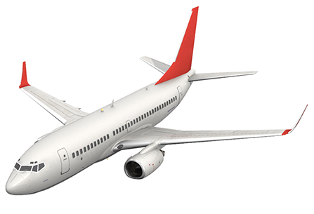
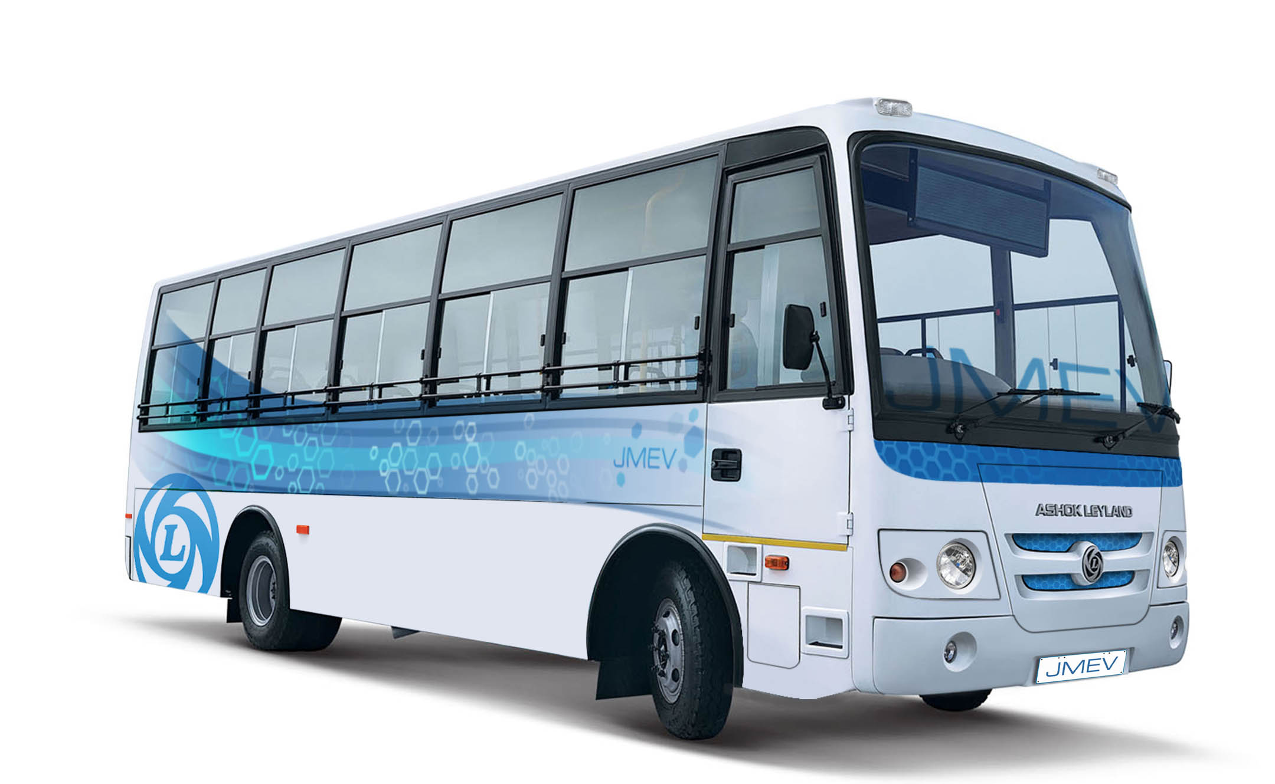
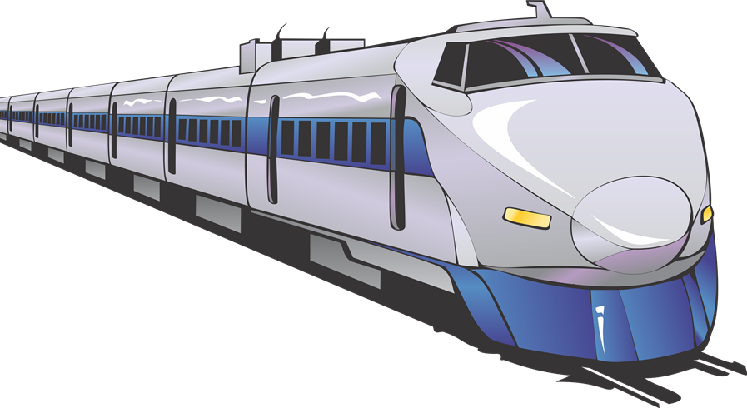
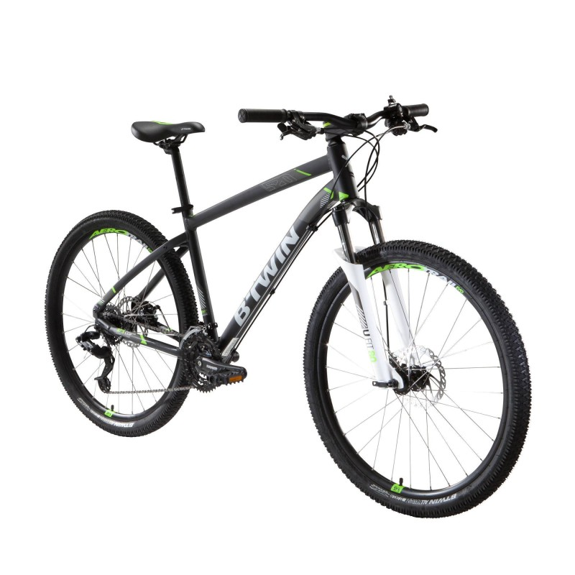
travel by …
car
ship
plane / air
bus / coach
bike
train
on foot

Slide 4
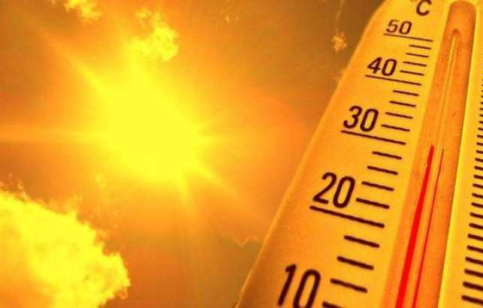
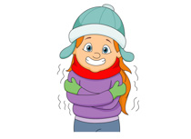
The weather
rainy
hot
sunny
cool
windy

Slide 5
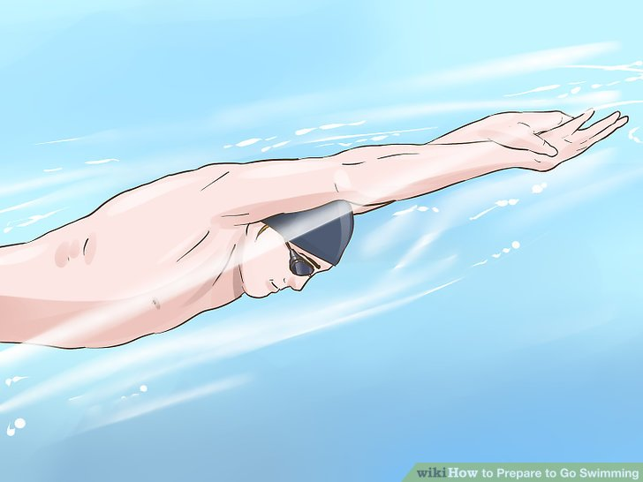
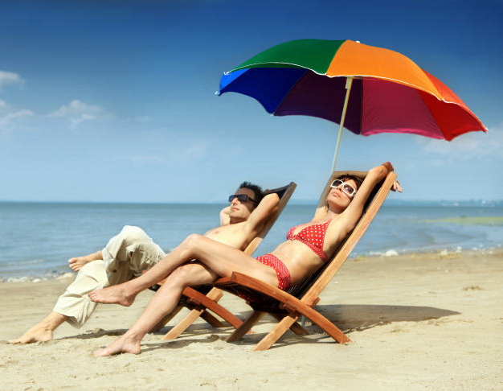
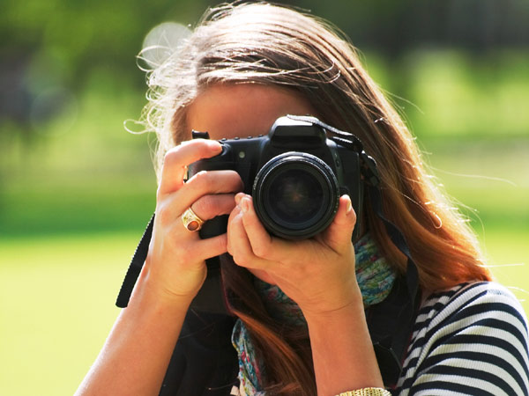
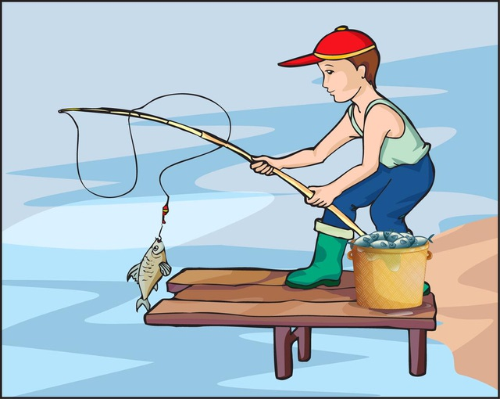
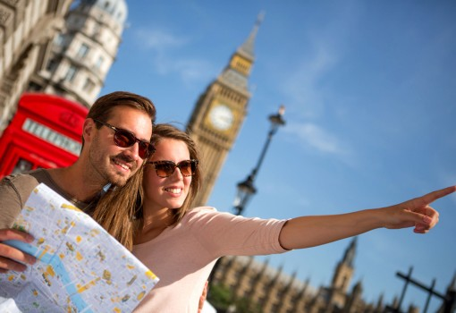
go sunbathing
go swimming
take pictures
go fishing
go sightseeing

Slide 6
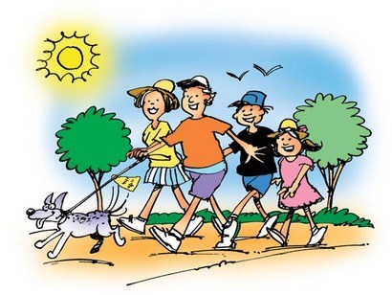
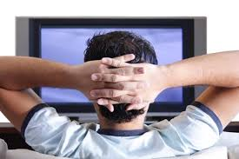
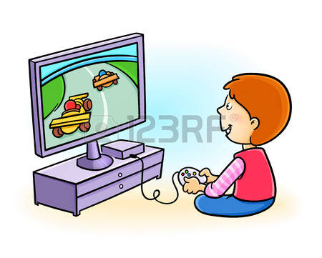
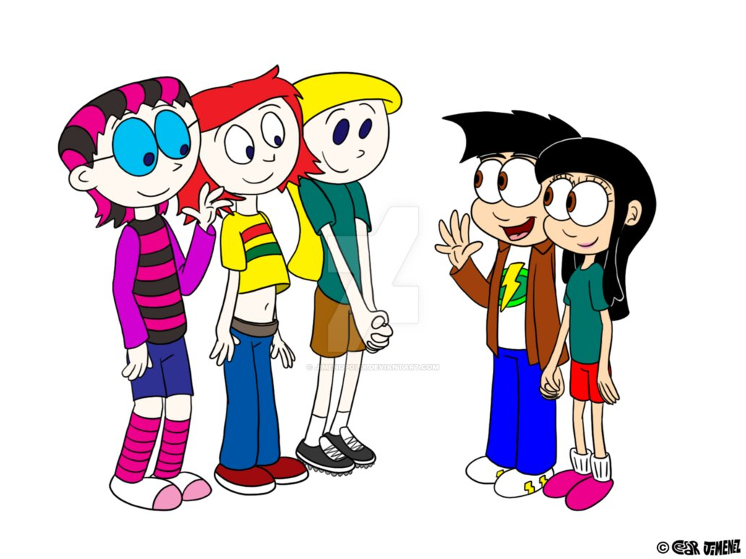
listen to music
go for a walk
watch films
meet friends
play computer games
read books

Slide 7
boring
exciting
relaxing
great

Slide 8
My summer holidays
On my summer holidays I went to the seaside with my family. I travelled by plane. The weather was hot and sunny. I went swimming, went sightseeing and took pictures. It was great.

Slide 9
My summer holidays
On my summer holidays I stayed in my hometown. The weather was cool and rainy in June. The weather was hot and sunny in July and August. I went swimming, watched TV and went for a walk. It was relaxing.

